Slide 1
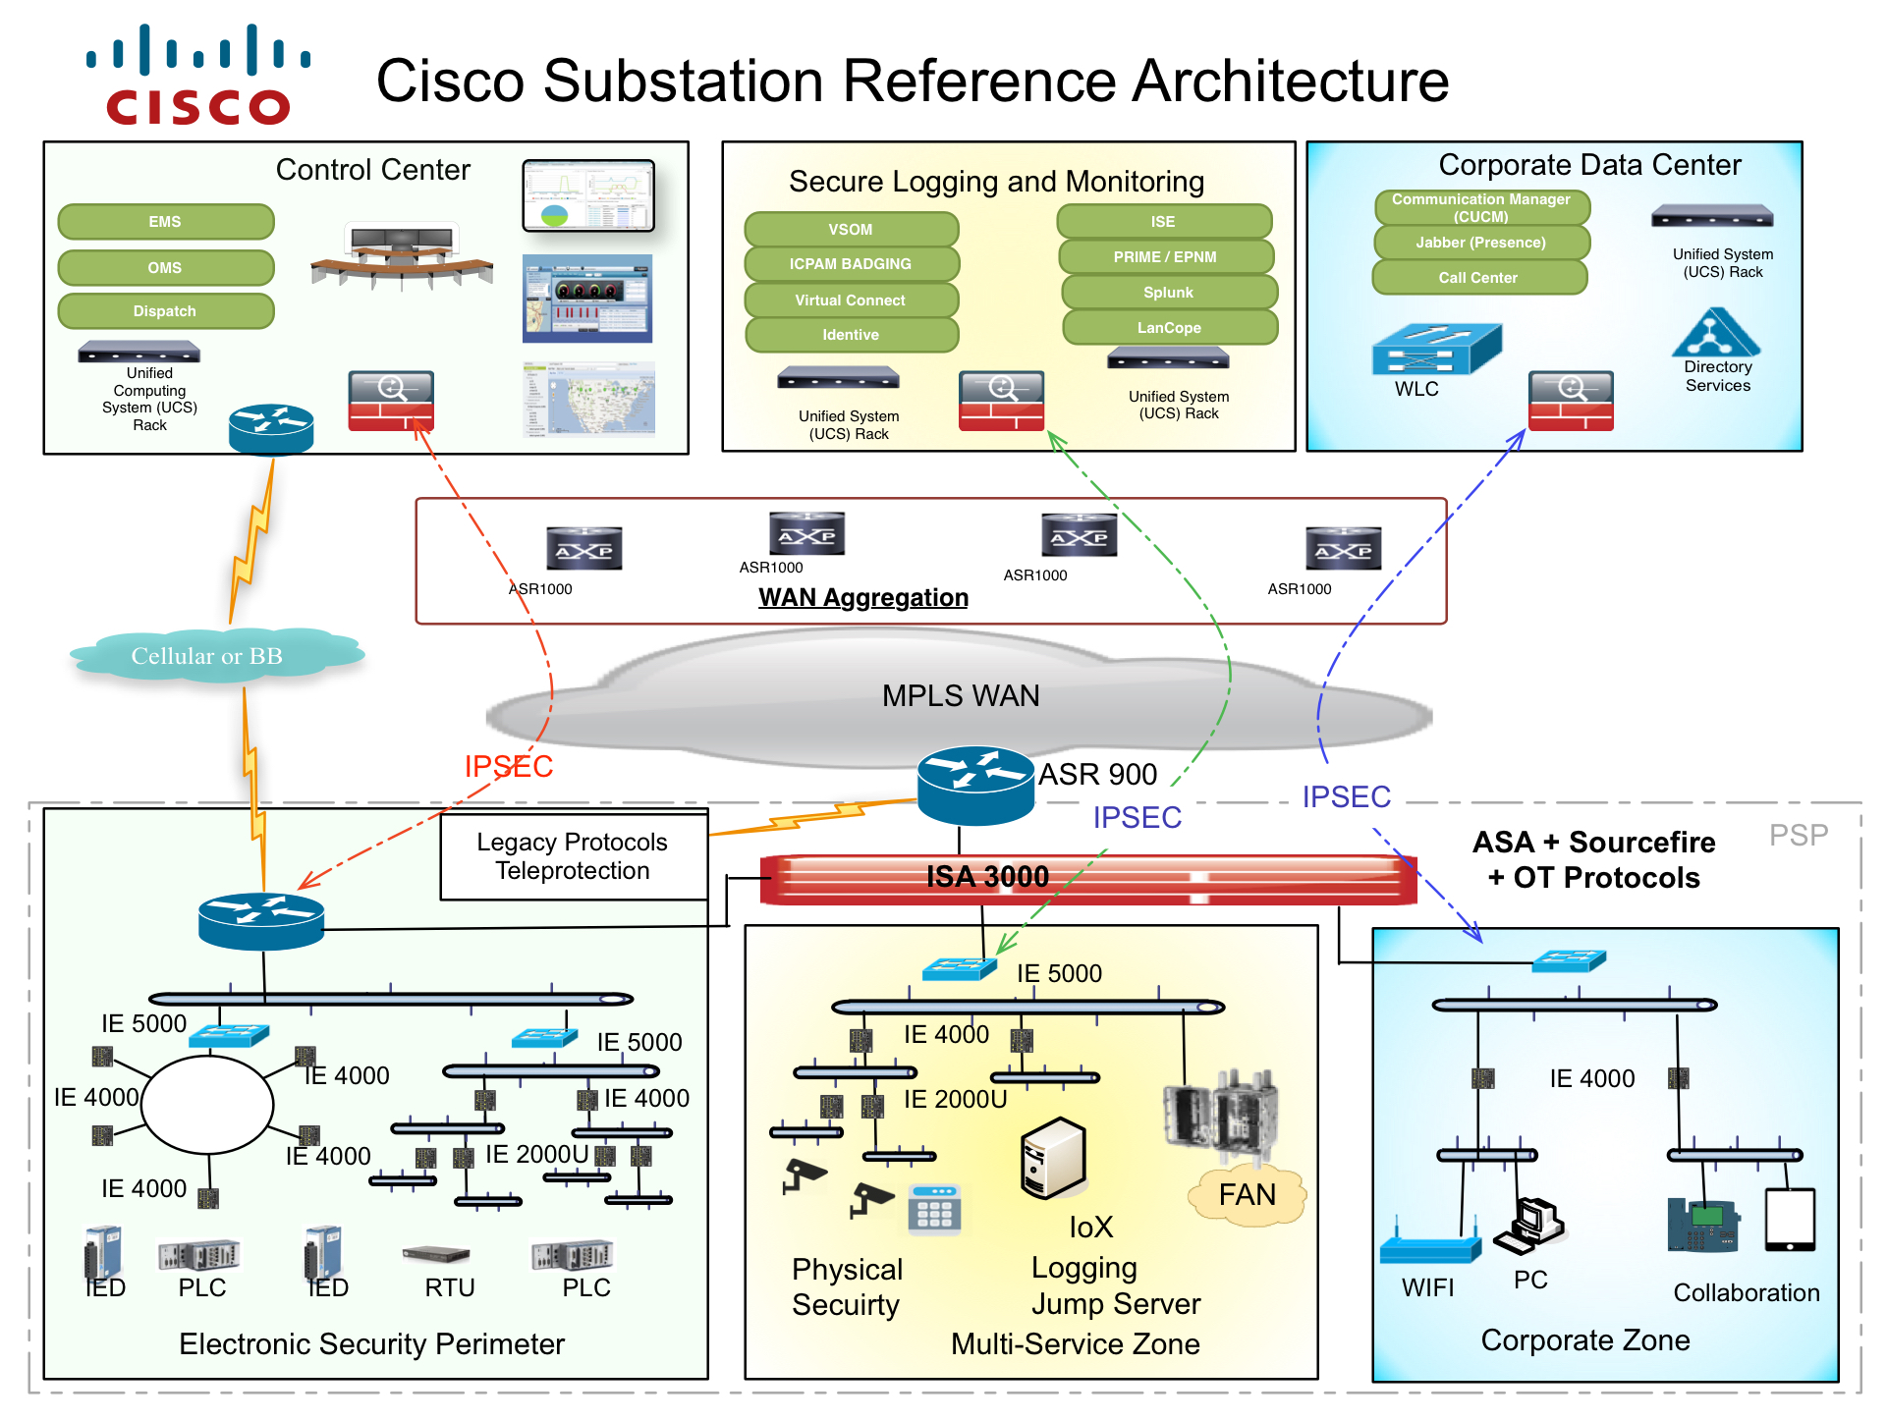
End to End Security
ISE with 802.1x Auth & Controls
Segmentation by use case ( ZONE )
Deep Packet inspection with IoT Signatures

Slide 2

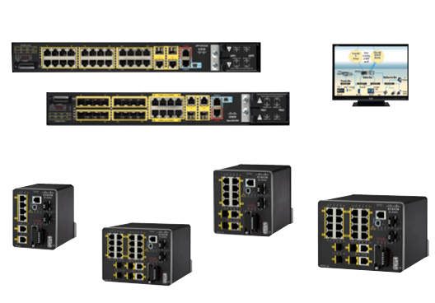
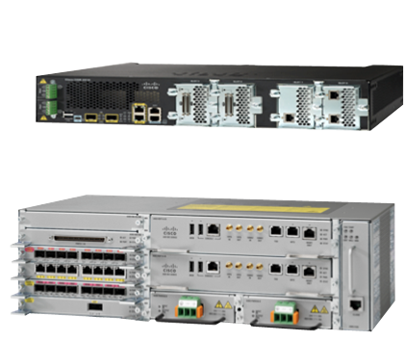
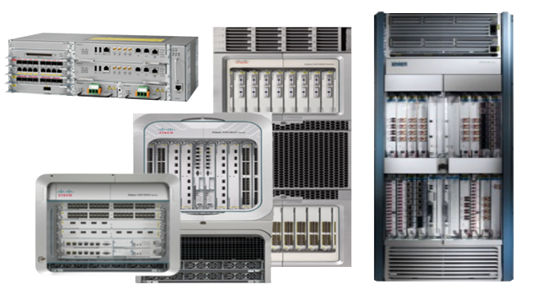
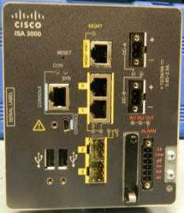
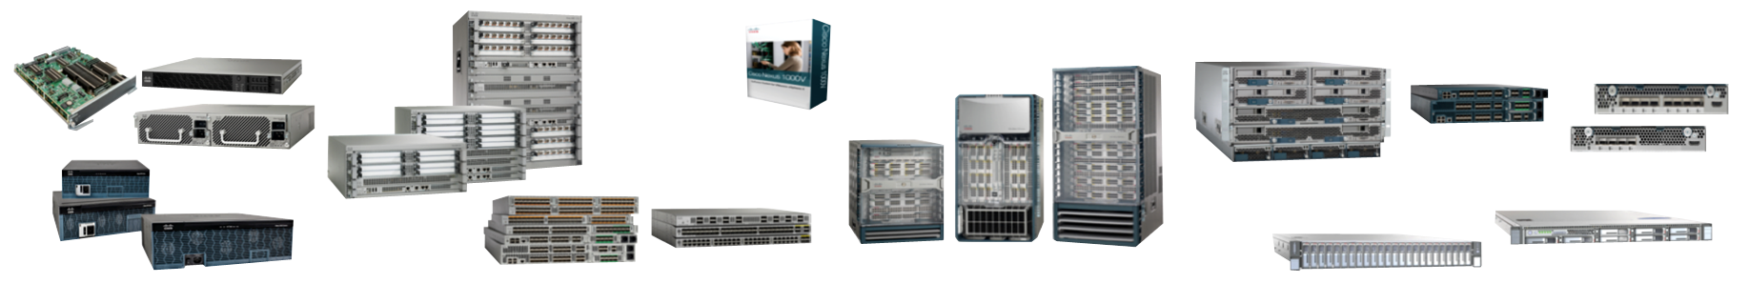
Route, Switch, and Compute Portfolio for Utilities
Substation LAN
Substation WAN Edge
Core Network
CGS-2k
IE-2000U, IE 4000
CGR 2010
ASR 903
ASR 9000
CRS
ASR 903
ISA-3000
IE-5000
Data Center and Control Center
ASA CX
Nexus 1000V
Nexus 7000
UCS Blade Servers
Fabric Interconnect & Extenders
ISR G2
UCS Rack Servers
ASR 1000
Nexus 2000-5000
Network Management
Prime Carrier / EPN-M
Prime Infrastructure
Prime Data Center

