Slide 1
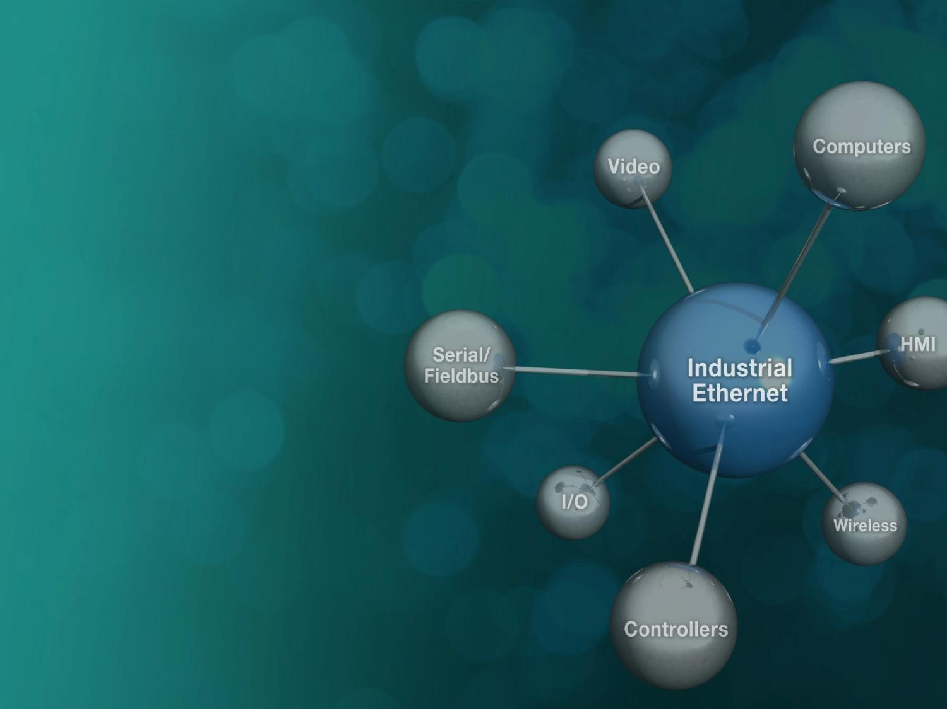
Moxa Smart Grid Technology Portfolio
Industrial Networking
Industrial Secure Routers
Industrial Ethernet Switches
IEC 61850-3 Ethernet Switches
Industrial Wireless LAN
Industrial Cellular Routers/Gateways/Modems
Media Converters
Serial Device Servers
Embedded Networking
Industrial Network Management
Software
Industrial Computing
Edge Computers
Industry-Specific Computers
Wireless Computers
Displays and Panel Computers
Remote Automation & Gateways
Modular RTU Controllers
Micro RTU Controllers
Ethernet, Serial, and Modular Remote I/O
Protocol Conversion Gateways

Slide 2

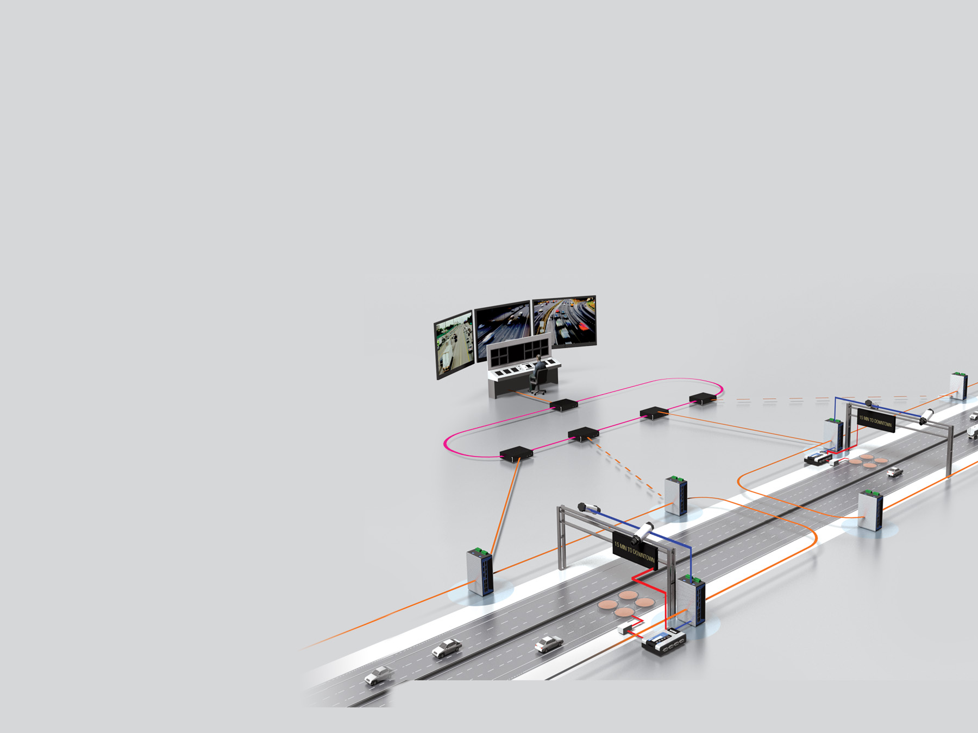
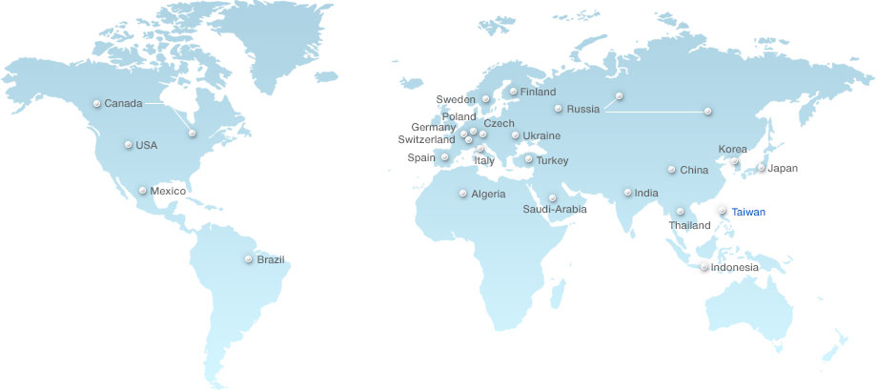
Moxa Successful SAS Deployment Worldwide
SAS: Substation Automation System
500+
Successful Substation
Deployments
From
Ultra High Voltage
to
Mid/Low Voltage
Leading in
Public Utilities
&
Enterprises
http://www.moxa.com/Solutions/Substation/Reference.htm

