Slide 1
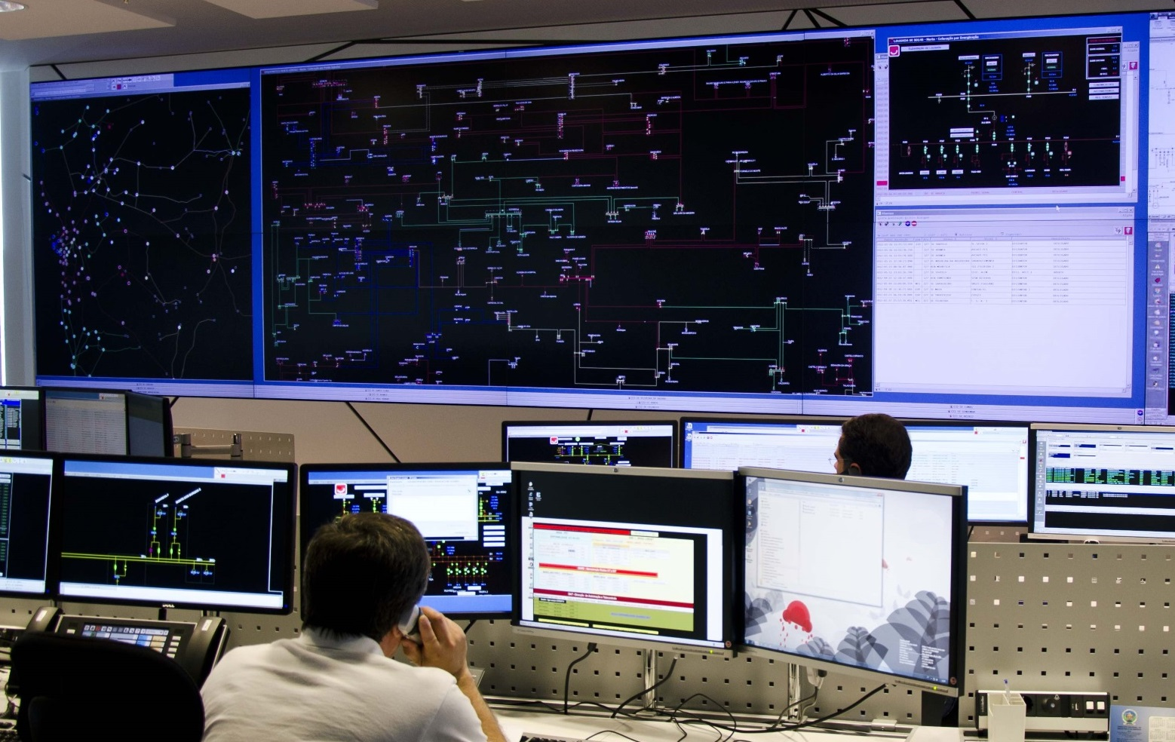


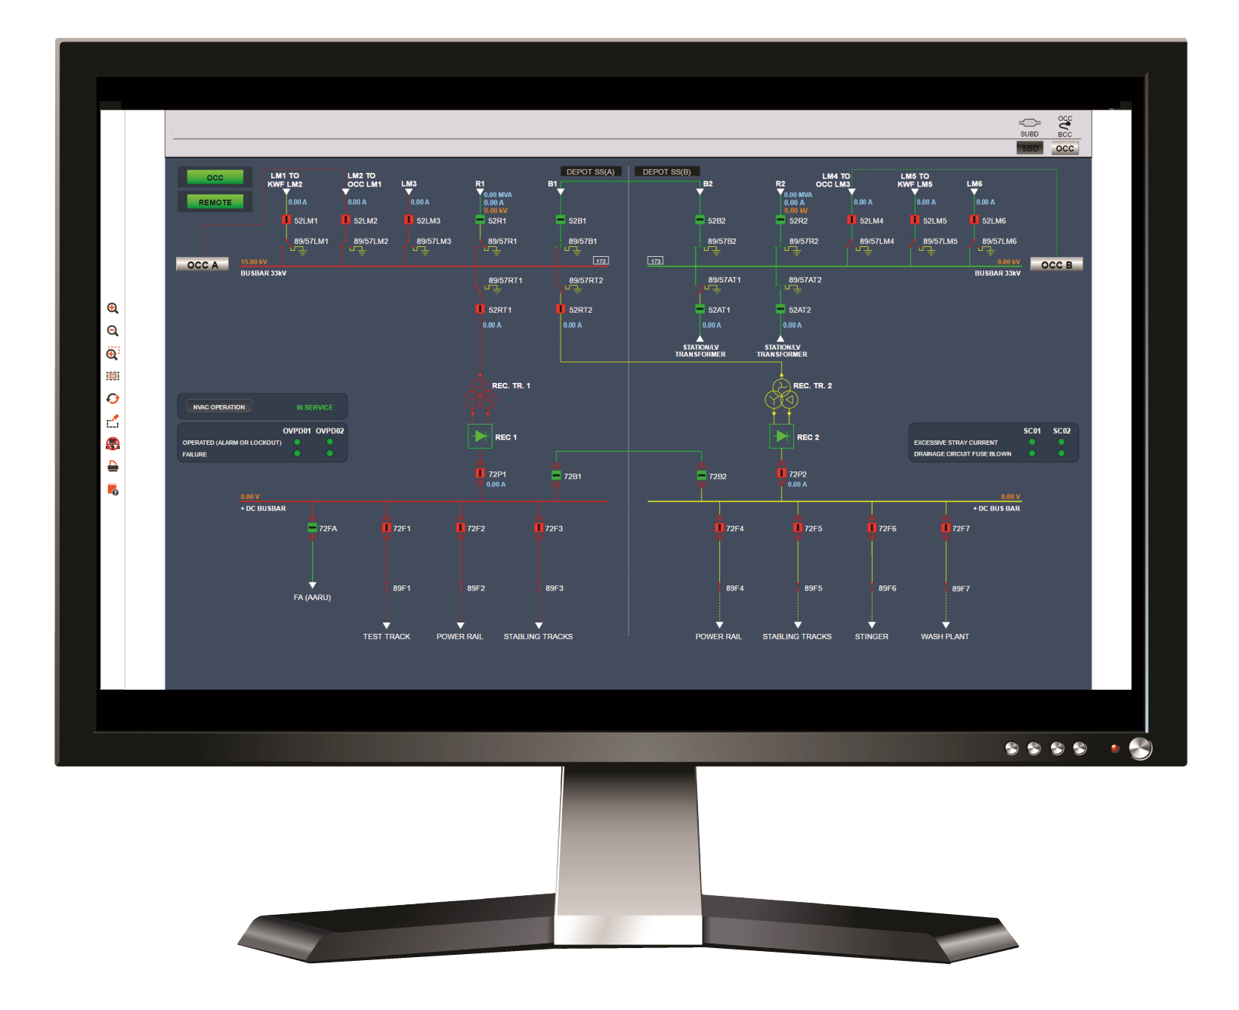
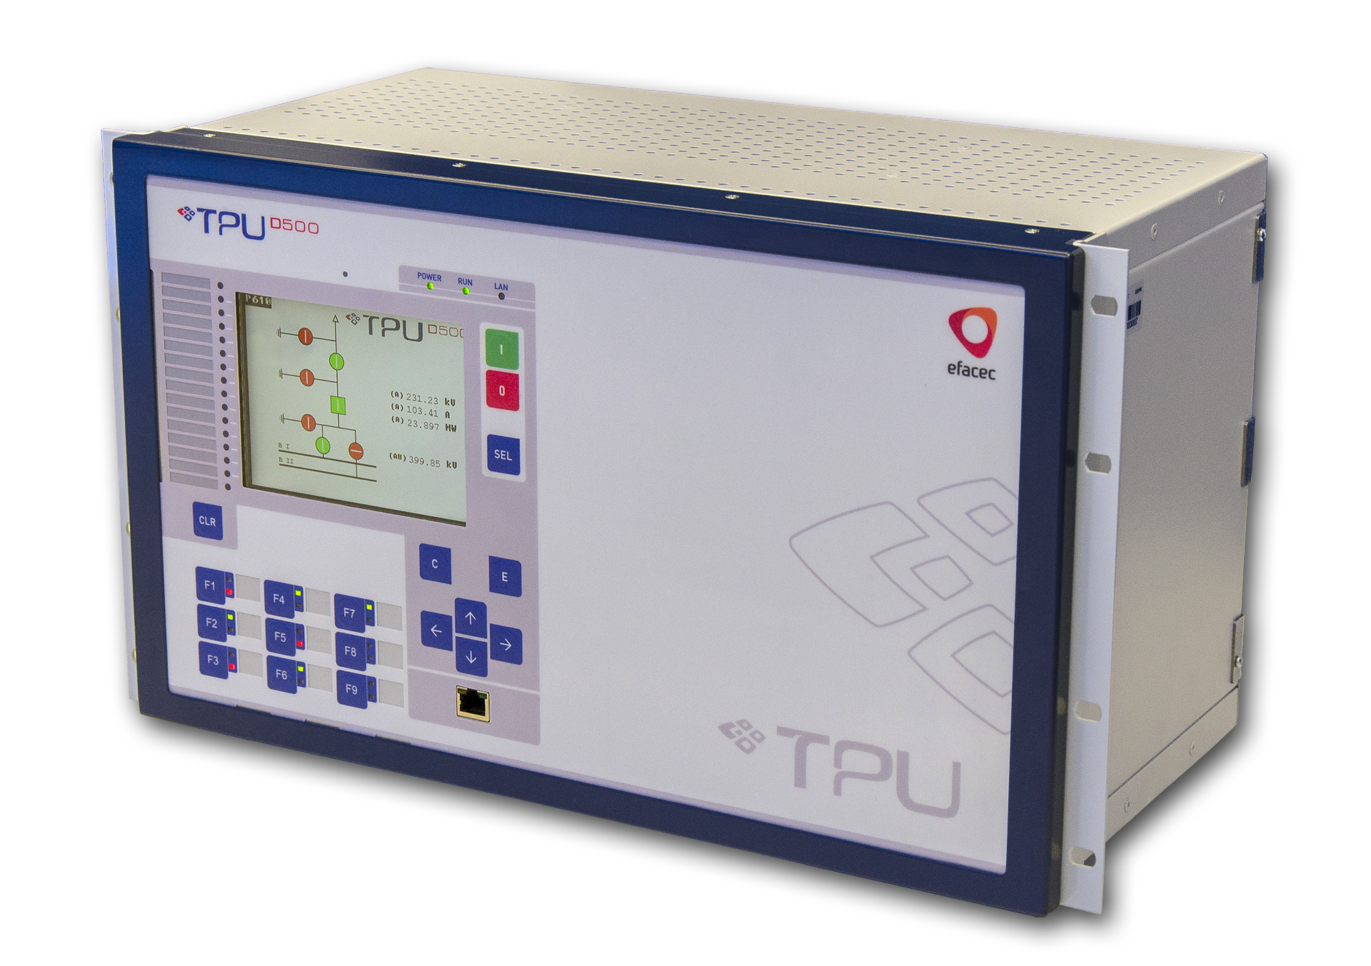
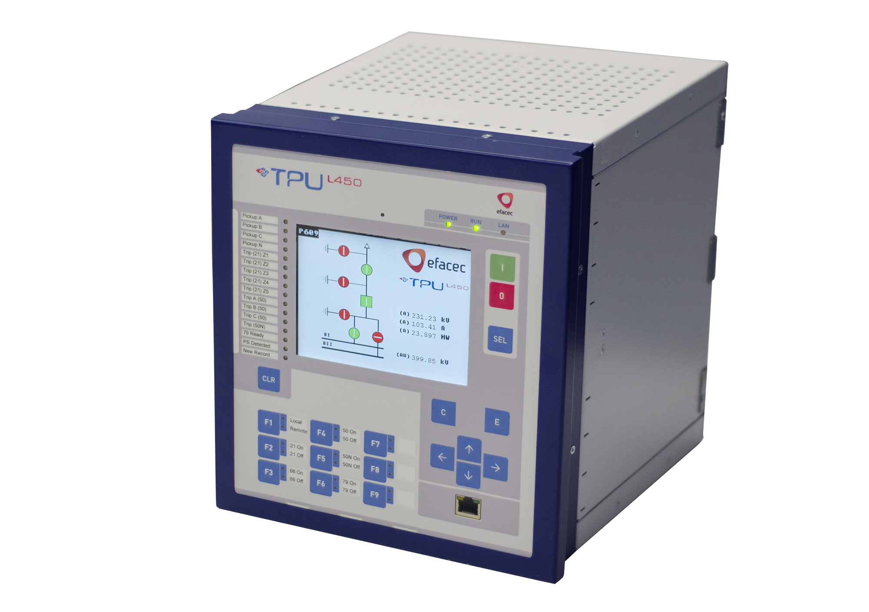
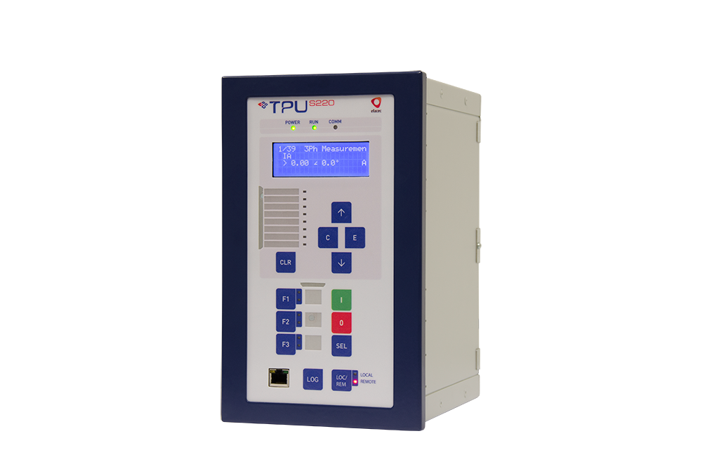
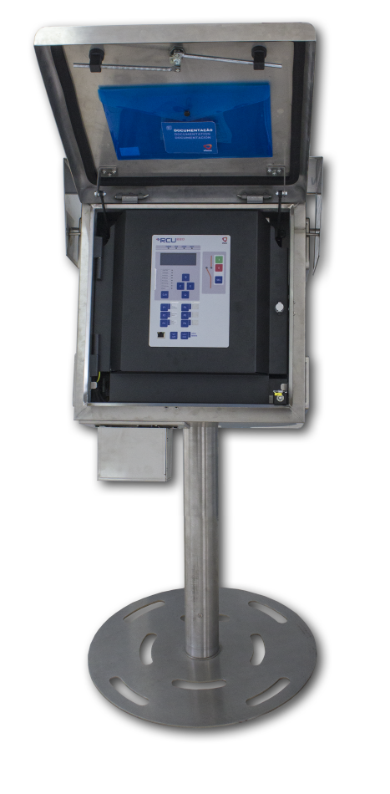
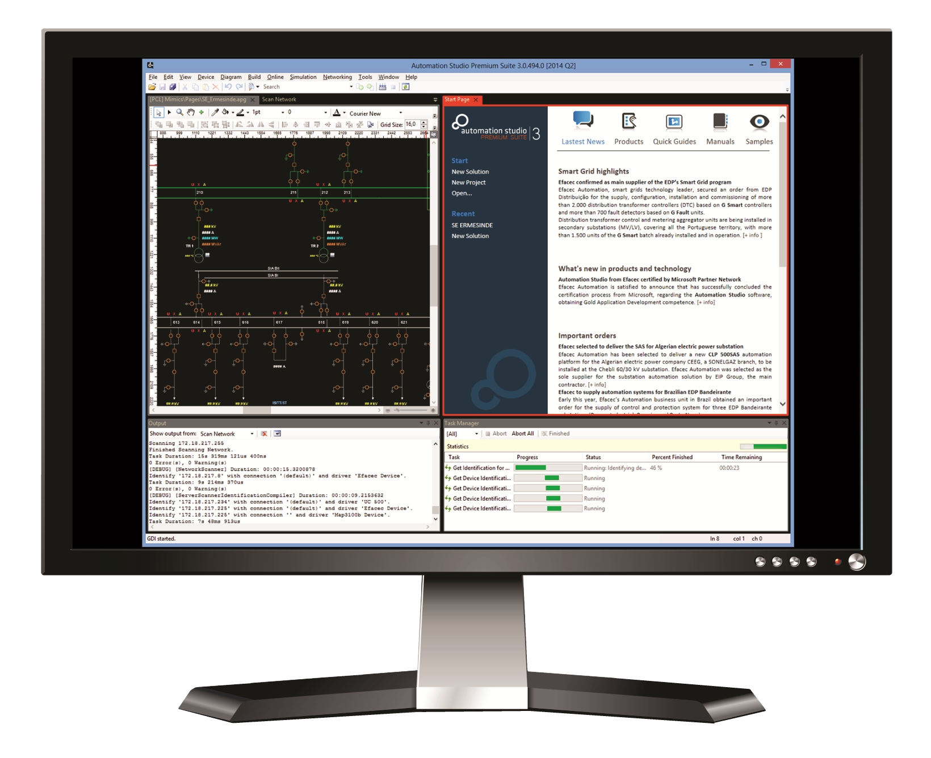
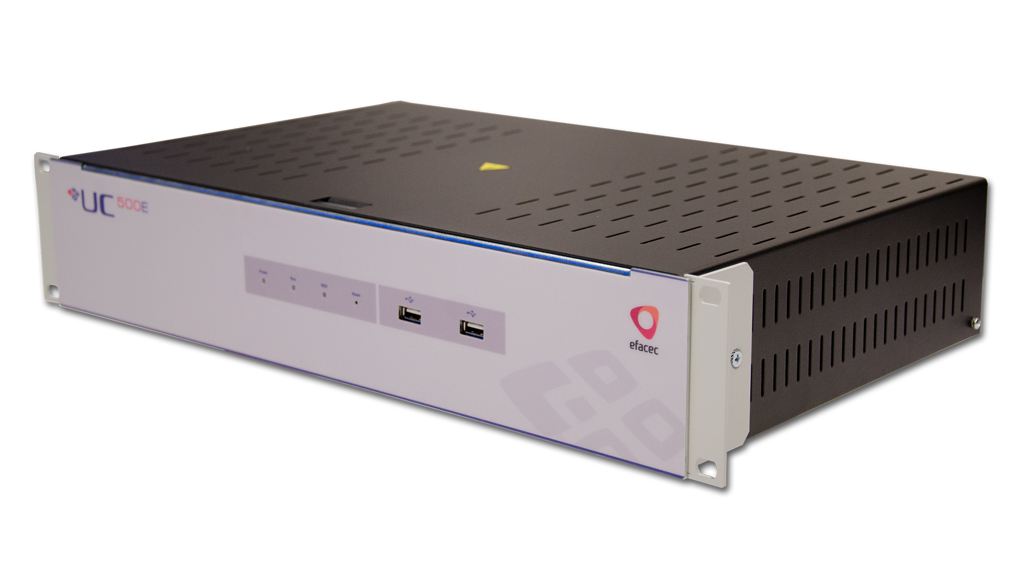
Experience in Network Management and Automation, since 1980
  WW references in over 50 countries
  System design, product development and project management
  8% of sales invested in R&D
  Solutions for Grid Management and Digital Substations
  SCADA / EMS / ADMS
  Full range of IEDs for Grid Protection, Automation & Control
SCADA Control Centre
Station and HMI | Transmission | Sub-transmission | Distribution | Feeder | System Engineering

Slide 2

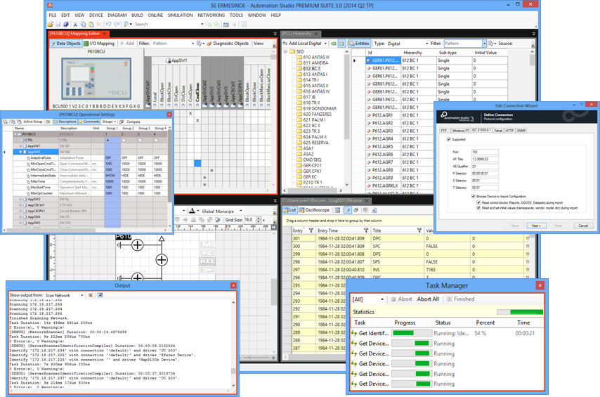

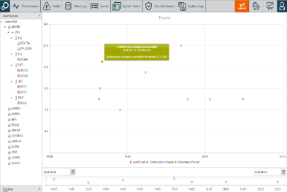
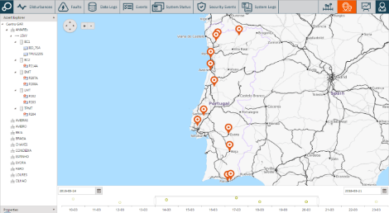
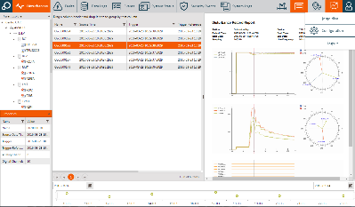

Showcasing here
System Engineering
  IEC 61850 vendor neutral based engineering
  Consistent, flexible and integrated tool environment
  System Management
  Centralized management for all stations and devices
  Standards-based platform for unified station O&M
  Protection IEDs
  Unified high-performing platform for protection and control applications
  Fit-for-purpose and flexible design, compliant with state-of-the-art standards

