Slide 1
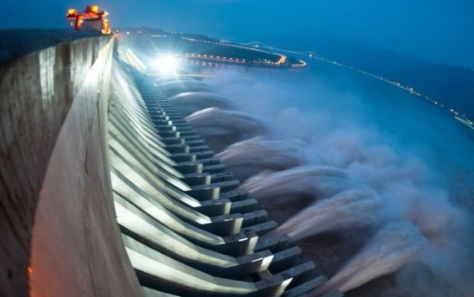
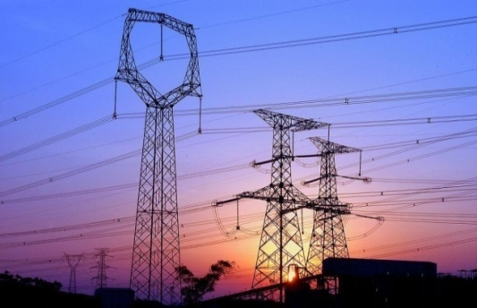
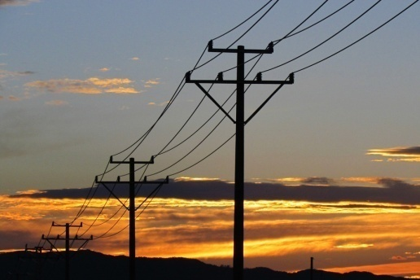

NR Electric----Power Stability Expert
Leading solution-provider to improve the
stability, reliability, efficiency and environmental friendliness of power system
  Generation
  Transmission
  Distribution
  Industrial
  Thermal/Gas-turbine
  Hydro/Pumped Storage
  Nuclear
  Renewable
  Up to 1000kV HVAC
  Up to ±800kV LCC-HVDC
  Up to ±320kV VSC-HVDC
  Distribution Management
  Micro-Grid
  BESS
  Metals
  Mining
  Oil and Petrochemical
  Railway and Subway

Slide 2

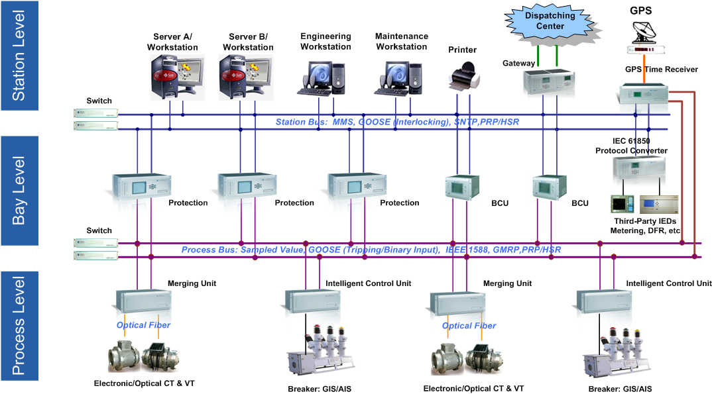
NR Electric----Experienced Digital Substation Pioneer
The proportion of
different voltage grade
Providing all products in process level,
bay level & station level

