Slide 1
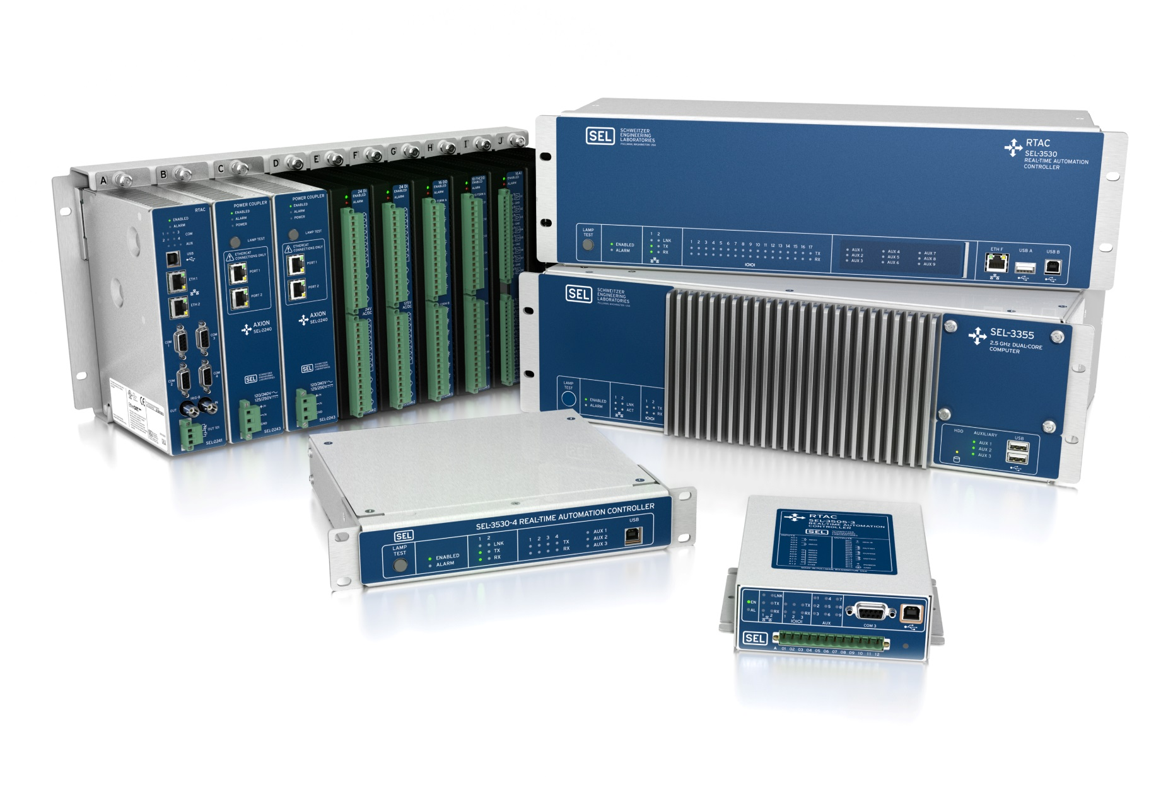

Best-in-Class IEC 61850
Gateways and Controllers
Deterministic processing with
rates as fast as 1 ms
Power management
and load shedding
Substation HMI
Built-in security with exe-GUARD® technology
Legacy protocols to IEC 61850 gateway

