Slide 2

Outline
Introduction
Switchgear Modeling in IEC 61850
Development of the Simulation Model
Test Setup
Results and Discussion

Slide 3
Introduction
IEC 61850 has become the preferred standard for substation automation systems (SAS) around the world
Testing and validating of control systems in a substation such as high voltage switchgear controls can be challenging due to the unavailability of an accurate replica test system
Control systems can be tested in a virtual environment by modelling them inside a real-time simulator

Slide 4
Switchgear Control
High voltage switchgear in an electrical substation operates in response to either a trip or a switch (opening and closing) command
Typically, only protection and control intelligent electronic devices (IEDs) at bay level can trip circuit breakers
A circuit breaker can either be switched locally with manual control or by a command from bay, station and/or remote levels
IEC 61850 defines data models for representing switchgear and their associated controls
These data models can be read and controlled by MMS communication protocol

Slide 5
Control Models
As different applications require different control behaviours, IEC 61850 defines four control models:
  Direct control with normal security
  SBO (select before operate) control with normal security
  Direct control with enhanced security
  SBO control with enhanced security

Slide 6
Originator Category (orCat)
Originator category (orCat) indicates who/what requested the change of state of a controllable value
Values for orCat | Explanation
not-supported | That value shall not be used
bay-control | Control operation issued from an operator using a client located at bay level
station-control | Control operation issued from an operator using a client located at station level
remote-control | Control operation from a remote operator outside the substation (for example network control center)
automatic-bay | Control operation issued from an automatic function at bay level
automatic-station | Control operation issued from an automatic function at station level
automatic-remote | Control operation issued from a automatic function outside of the substation
maintenance | Control operation issued from a maintenance/service tool
process | Status change occurred without control action (for example external trip of a circuit breaker or failure inside the breaker)

Slide 7
Control Parameters
An originator’s right to possess the control authority for a particular switch depends on a prescribed set of control parameters
Control Parameter | Description (as per IEC 61850-7-4)
XCBR/XSWI/CSWI.Loc | Shows the control behaviour of the logical node
LLN0.MltLev | Shows if more than one source of control commands is accepted at a certain level at the same time
CSWI.LocSta | Shows the switching authority at station level.

Slide 8
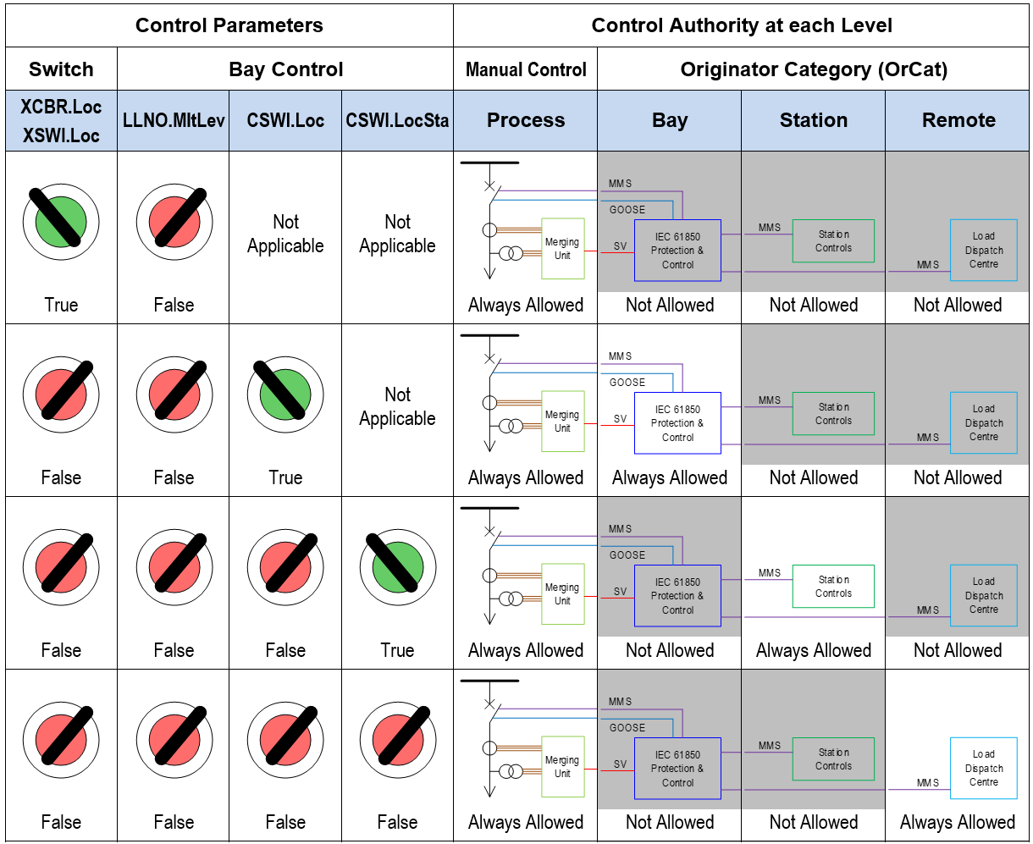
Control Parameters & Control Authority
LLN0.Mltlev = False

Slide 9
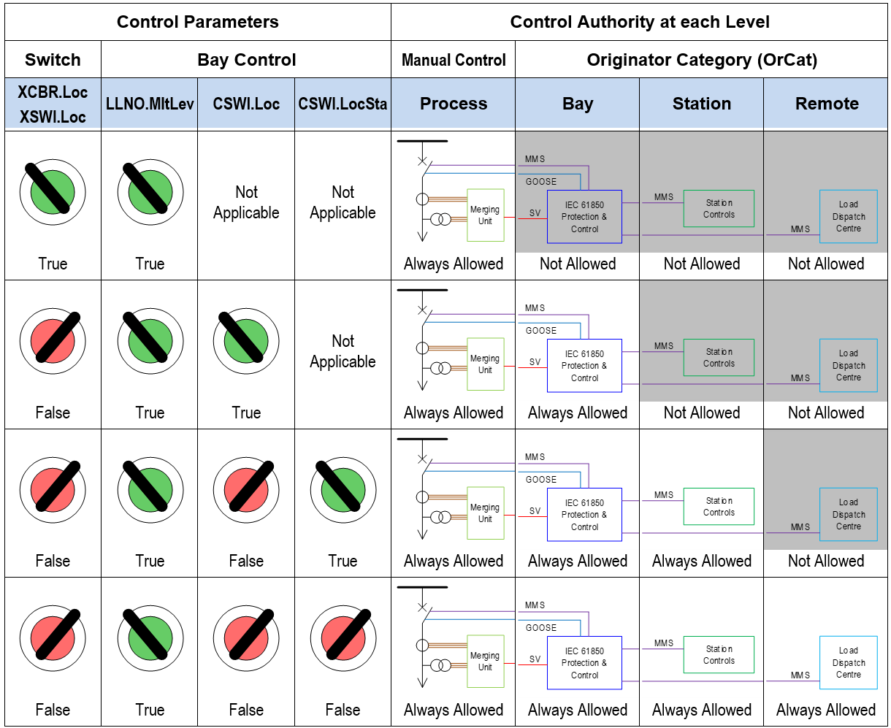
Control Parameters & Control Authority
LLN0.Mltlev = True

Slide 10
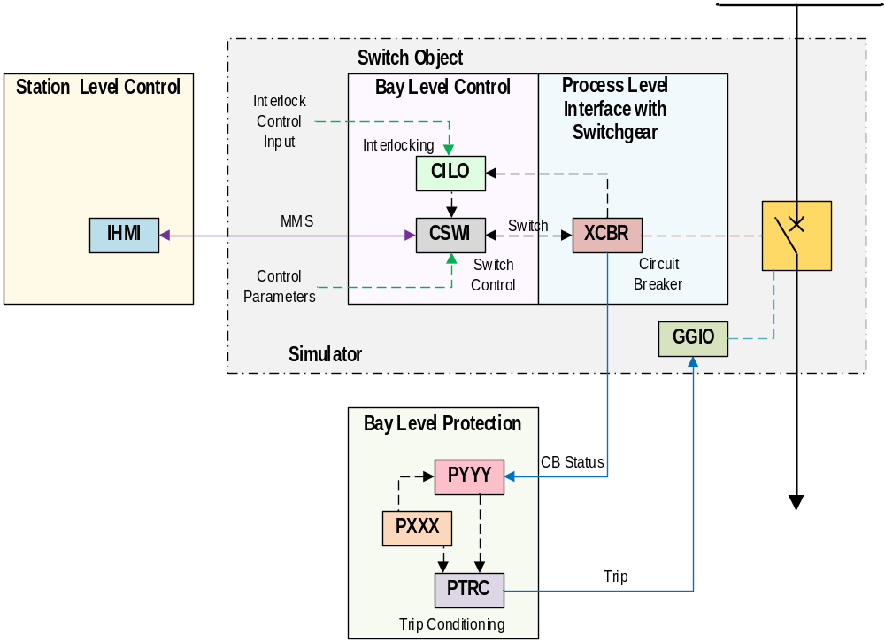
Simulation Model

Slide 11
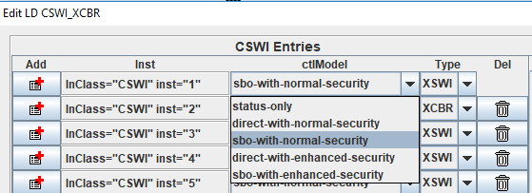
Initialization of Switch Objects
All four control models are implemented with an additional “status only” option
Control model type is chosen when LN instances are first created using the IED configuration tool
Type of the switch (XCBR or XSWI) is also chosen at this point
All three LN instances (XCBR/XSWI, CSWI, CILO) are created simultaneously and locally interlinked

Slide 12
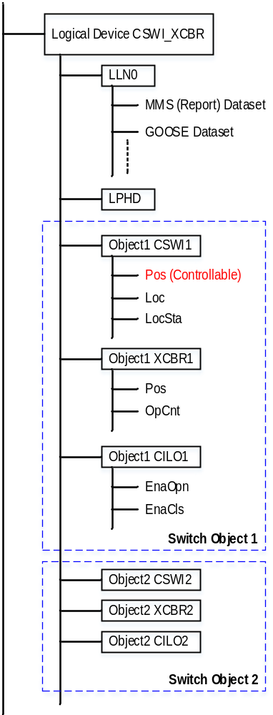
Data Model Structure
All related LN instances are grouped into a separate Logical Device (LD)

Slide 13
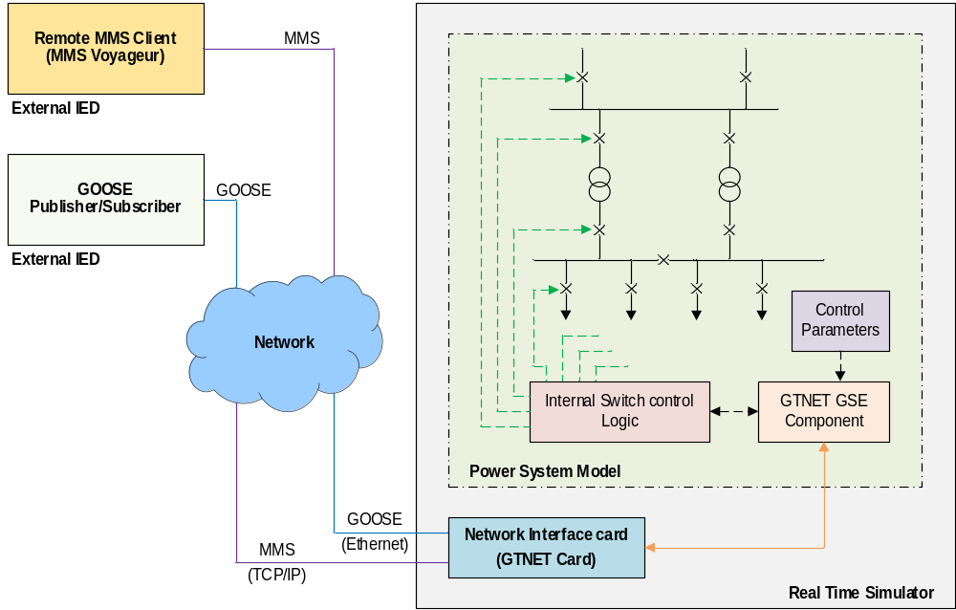
Test Setup

Slide 14
Test Setup
A MMS client program (MMS Voyageur) available in RSCAD was used as the MMS client for testing
Testing was carried out in two phases
Firstly, functional aspects of the developed simulation model were tested to confirm its correct operation
Under functional testing:
  All eight scenarios were tested (as per 7-4 Annex B)
  Tests were repeated for interlock checks
  Tests were repeated for each control model
  Operation was tested according to state machines

Slide 15
Test Setup
Secondly, the model was used in a simulation of a substation to evaluate its performance under realistic scenarios
Operation switch objects ware tested according to a test plan considering practical consideration in a SAS
All switching operations during functional testing and integrated testing with the example substation exhibited expected performances

Slide 16
Results and Discussion
The simulation model presented enables:
Producing a testing environment for real switch controllers (operators) in a SAS to be tested, individually as well as a group
Testing and verification of the electrical interlocks in the SAS
Interfacing switch objects in the simulation with actual circuit breakers via hardwired I/O connections of the simulator
Integration of switchgear controls into the coordinated operation of the entire SAS, including both protection and control systems

Slide 17

Questions

