Slide 1





A Better Way To Test:
IEC 61850 Testing Features
  Joe Stevens
  Marketing Manager
  Triangle MicroWorks
  jstevens@trianglemicroworks.com

Slide 2
Make IEC 61850 More Agile
Specify
Design
Build
Commissioning
Field Testing
Production
Testing
Create/Follow Test Plan
Use Simulations
Intelligent Troubleshooting
Verify Configurations
Test throughout the process

Slide 3

Simple Example
Goal: create and follow a test plan
Other Bays
Breaker Failure
Bay 1
Breaker Failure
Trip
Protection
Breaker
Control
Question: What testing approach should we take?

Slide 4
IEC 61850 Testing Approach
Test Client
Setup IEDs For Tests
Test Set
Subscribe To GOOSE
Breaker Failure
Publish Simulated GOOSE
Publish Simulated
Sampled Values
Trip
Physical I/O
Question: What are we trying to test?

Slide 5
So Many Testing Options
Use real data or switch to test data on inputs?
(Quality Bits)
Test Client
Place entire IED in test mode?
(LD’s or LN’s)
Test
Set
Use real subscriptions
for test set data?
(Simulate Bit)
Physically isolate or
block outputs?
(Test Modes)
Question: Which testing features do vendors support?

Slide 6
Considerations for Specification
Test Features for IEDs and Tools
Data quality supported on inputs?
Which test modes are needed?
How are modes activated in IEDs (remote/local)?
Test set subscription changed with simulation bit?
How can controls be tested (control mirroring)?
How can other test data be used on inputs (InRefs)?
Support for LGOS and LSVS to see subscription status?
How are GOOSE/SV subscriptions configured?
Note: Required features depend on your test plan

Slide 7
Test Client Requirements
Test Client
Identify simulated and real GOOSE and sampled values
Set test modes
Verify IED configurations
Test
Set
View subscription status of IEDs
View data and quality
Monitor virtual outputs of IEDs

Slide 8

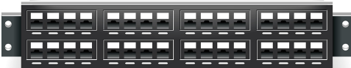
Troubleshoot GOOSE and Sampled Values
SCL
Sniffer
<GSEControl name="gcb1" appID="L02BPU/gcb1">
<GSEControl name="gcb2" appID="L03BPU/gcb2">
<GSEControl name="gcb3" appID="L04BPU/gcb3">
<GSEControl name="gcb4" appID="L05BPU/gcb4">
GoID | IED | Timeout | Match SCL | Simulate | ConfRev
gcb1 | L02BPU | No | SCL | False | 14
gcb1 | ------ | No | Wire | False | 13
gcb3 | L04BPU | No | Match | False | 14
gcb3 | L04BPU | No | Match | True | 14
Misconfigured
Simulated
Timed out
Network Config
GOOSE
Sampled Values
Test Set
Value Created: identify communication issues earlier and faster

Slide 9
Verify IED Configurations
Goal: verify that IEDs are configured according to design
Object | Value
Pos
ctlModel | sbo
sboTimeout | 30000
Object | Value
Pos
ctlModel | status-only
sboTimeout | 30000
Highlight Differences
Parse SCL Model
Discover IED Model
?
SCD or
CIDs
Value Created: reduce test time by finding misconfigurations earlier

Slide 10
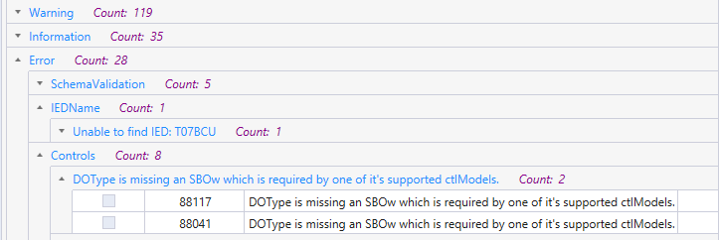
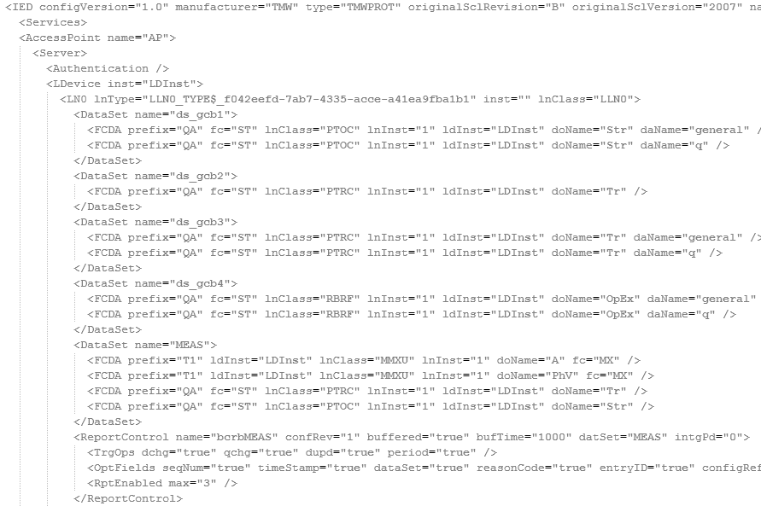
Verify SCL Files
Goal: verify that SCL files are interoperable
Identify missing parameters or non-compliant SCL
Resolve control blocks, external references, and datasets
Distinguish issues by severity
Value Created: find SCL issues early to accelerate testing later

Slide 11
Test Early with Simulated IEDs
Goal: test more during design phase
Other Bays
Simulated IEDs
Real Device Under Test
Bay 1
Protection
Value Created: reduce test time later during FAT and commissioning

Slide 12
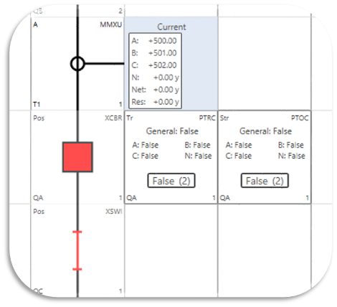
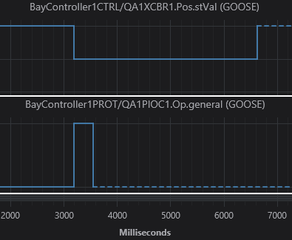
Observe Conditions During Tests
Goal: view data from multiple sources
  Find the data you need
    Filter the “necessary” data for each test
  View data at the system level
    Navigate data across multiple IEDs in the system
  Visualize data
    Show test data in a clear way
Value Created: make tests easy for all users (design, build, test)

Slide 13
Key Takeaways
Test Throughout All Stages
Discover misconfigurations when it costs less to fix
Follow Test Plan
Create a plan that includes early stage tests
IEC 61850 Testing Features
Enable your test plan with IEC 61850 test features

