Slide 1


Cigre Paris
27-31 August 2018
Palais de Congrès

Slide 2
Actionlist
Upload SCL files to website
  Doble, RTDS, Sisco, TMW
LCD screen rental 24”– on the UCAIug website
  Doble,Sisco, RTDS, SEL
UCA Banner for long wall
  End July (Margaret/Ralph)
Henny ordered the Badges for the event - Done
Content USB sticks End July (Margaret & Henny)
    (Platinum 100MB, Gold 60MB, Silver 20MB)
    Load on the website by end of this week (7/27/18)
    RTDS, DNVGL, Doble, Sisco, Sutton to load SEL

Slide 3
Actionlist
Slide running presentation End of July (Margaret)
    (Platinum 3, Gold and Silver 2 slides)
    Send to Margaret by 8/7/18 – latest!
    RTDS, Doble, TMW, DNVGL, SEL
Order CAT 6 cables copper and extender
    Are ordered, status delivery?
Update Demo Flyer
    Done
Presentation Schedule Poster End of July (Margaret)
UCAIug Cigre Pressrelease > Press center
Prepare announcement 61850 booth meeting > Press center (or delegate list?)

Slide 4
Booth logistics
Busticket from Charles de Gaulle, no costs
Sunday: Access to the Opening Ceremony on Sunday from 4pm & cocktail afterwards
Monday: 61850 meeting at 4pm, open for all
  Snacks and wine
Monday: cocktail open to all in the Exhibition Halls on the 3 levels, from 6 pm to 8 pm
Booth Catering:
  Drinks (coffee, tea, water, coke)
  Daily lunch
  Popcorn for visitors
  Stroopwafels for visitors

Slide 5
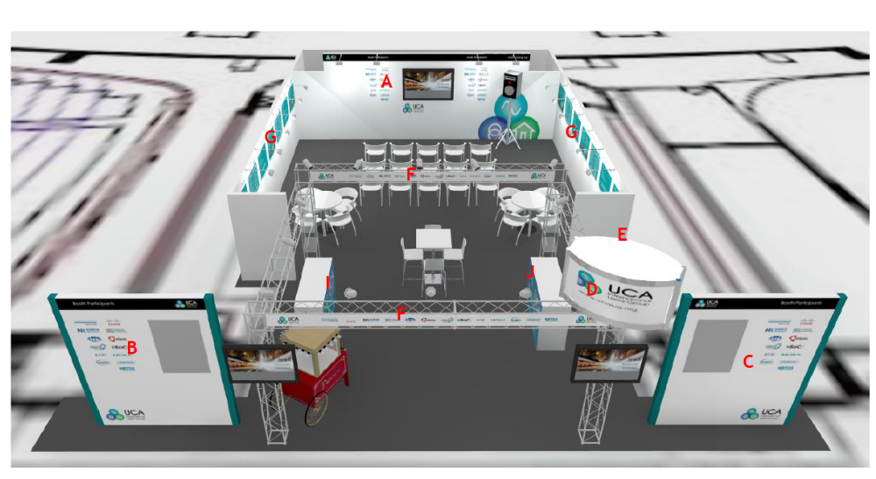
Signage

Slide 6
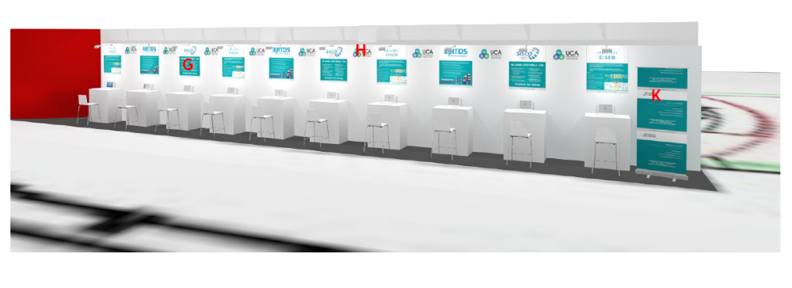
Signage

Slide 7
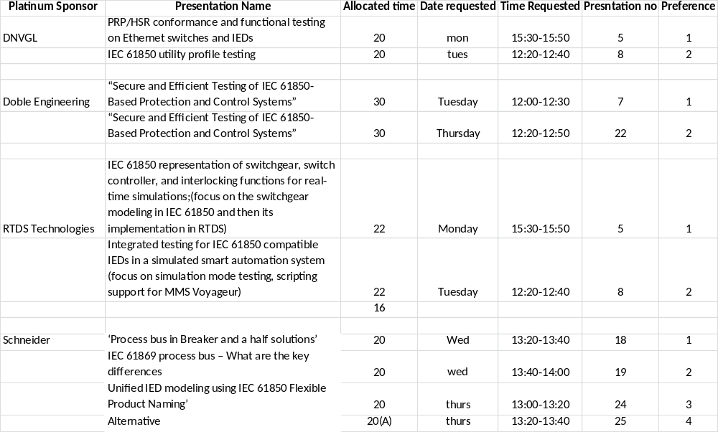
Booth Presentations

Slide 8
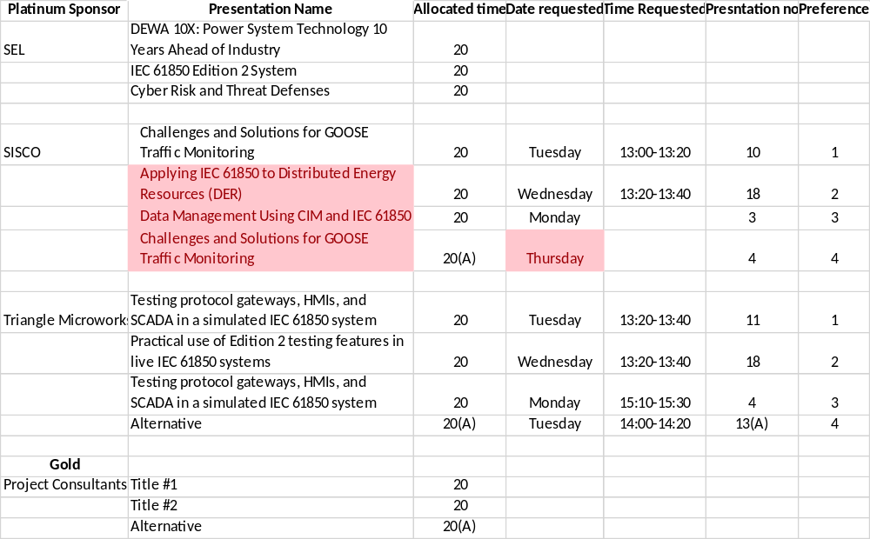
Booth Presentations

Slide 9
Open slots: presentations Monday
Time | no | Assigned to | Pref
14.10-14.30 | 1 | OPEN
14:30-14:50 | 2 | PCI – ERCOT’s nodal market solution | 1
14:50-15:10 | 3 | SISCO: Data Management Using CIM and IEC 61850 | 3
15:10-15:30 | 4 | TMW: Testing protocol gateways, HMIs, and SCADA in a simulated IEC 61850 system | 3
15:30-15:50 | 5 | DNV GL PRP/HSR conformance and functional testing on Ethernet switches and IEDs (Bas Mulder) | 1
15:50-16:10 | 6 | RTDS IEC 61850 representation of switchgear, switch controller, and interlocking functions for real-time simulations;
16:10-18.00 |  | UCA 61850 User’s Group Meeting Chair: Bas Mulder

Slide 10
Open Slot presentations Tuesday
Time | No | Assigned to | Pref
12.00-12.30 | 7 | Doble: “Secure and Efficient Testing of IEC 61850-Based Protection and Control Systems” (30 min presentation) | 1
12:20-12:40 | 8 | RTDS: Integrated testing for IEC 61850 compatible IEDs in a simulated smart automation system | 2
12:40-13:00 | 9 | PCI- T-nexus AEP’s Network Model Management Solution | 2
13:00-13:20 | 10 | SEL: 10X: Power System Technology 10 Years Ahead of Industry - IEC 61850 Edition 2 System | 1
13:20-13:40 | 11 | TMW Testing protocol gateways, HMIs, and SCADA in a simulated IEC 61850 system | 1
13:40-14:00 | 12 | SISCO: Challenges and Solutions for GOOSE Traffic Monitoring
14:00-14:20 | 13 | OPEN

Slide 11
Slot assignment presentations Wednesday
Time | Slot No | Assigned to | Pref
12.00 – 12.20 | 14 | DNV GL IEC 61850 utility profile testing (Bas Mulder) | 2
12:20 – 12:40 | 15 | TMW: Practical use of Edition 2 testing features in live IEC 61850 systems | 2
12:40 – 13:00 | 16 | SEL: Using IEC 61850 communications for Wide Area synchronized analog data acquisition to create previously impossible solutions | 3
13:00 – 13:20 | 17 | SISCO: Applying IEC 61850 to Distributed Energy Resources (DER) | 2
13:20 – 13:40 | 18 | Schneider Electric ‘Process bus in Breaker and a half solutions’ - Tutorial | 1
13:40 – 14:00 | 19 | Schneider Electric ‘IEC 61869 process bus – What are the key differences – | 2
14:00 – 14:20 | 20 | SEL: 10X: power system technology 10 years ahead of industry – cyber risk and threat defenses | 2

Slide 12
Open Slots presentations Thursday
Time | Slot No | Assigned to | Pref
12:00 – 12:20 | 21 | OPEN
12:20 – 12:50 | 22 | Doble:“Secure and Efficient Testing of IEC 61850-Based Protection and Control Systems” (30 min presentation) | 2
12:40– 13:00 | 23 | OPEN
13:00 – 13:20 | 24 | Schneider Electric Unified IED modeling using IEC 61850 Flexible Product Naming | 3
13:20 – 13:40 | 25 | OPEN
13:40– 14:00 | 26 | OPEN

Slide 13
IEC 61850 Breaker Failure Demo – IED Configuration Guidelines - Ralph
  July 25 - Second round of ICD files due
  Aug 8 - Final SCD/CID files available for testing
Aug 26 - Setup and test at Cigre (Sunday, 2 pm)
Questions/remarks?

Slide 14
Any other business
Shipping your collateral: http://www.cigre-exhibition.com/wp-content/uploads/sites/1/Transport-Customs-Handling2.pdf
Booth hand-over: Sun. 26th August, 2pm
Dismantling booth: Fri. 31st August, 4pm

