Slide 1


Cigre Paris
27-31 August 2018
Palais de Congrès

Slide 2
Booth logistics
Sunday:
  Building up demo as of 2pm
  Access to the Opening Ceremony on Sunday from 4pm & cocktail afterwards
Monday:
  61850 meeting at 4pm, open for all, snacks and wine
  Show is open until 8pm
  Cocktails open to all in the Exhibition Halls on the 3 levels, from 6 pm to 8 pm
Friday: tear down booth as of 4pm

Slide 3
Security
Security ordered:
Sun 26/08 19.00-8.00
Mon. 27/08 18.30-8.00
Tue. 28/08 18.30-8.00
Wed. 28/08 18.30-8.00
Thu. 29/08 18.30-8.00

Slide 4

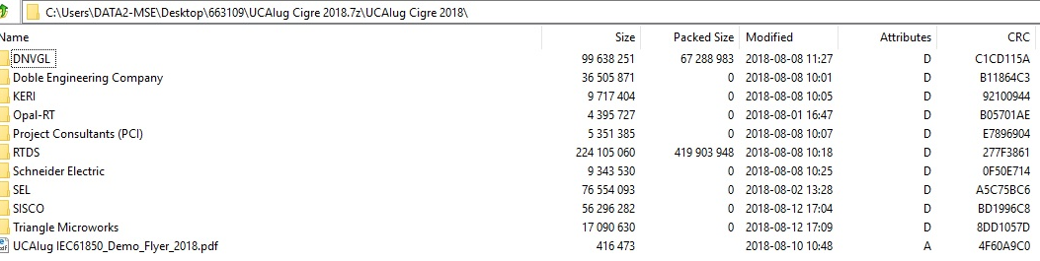
Actionlist – done!
CAT 6 cables copper – received
Flyer – done (printed)
USB sticks ordered: 3.0 – 16GB
  delivery Mon. 20 August

Slide 5
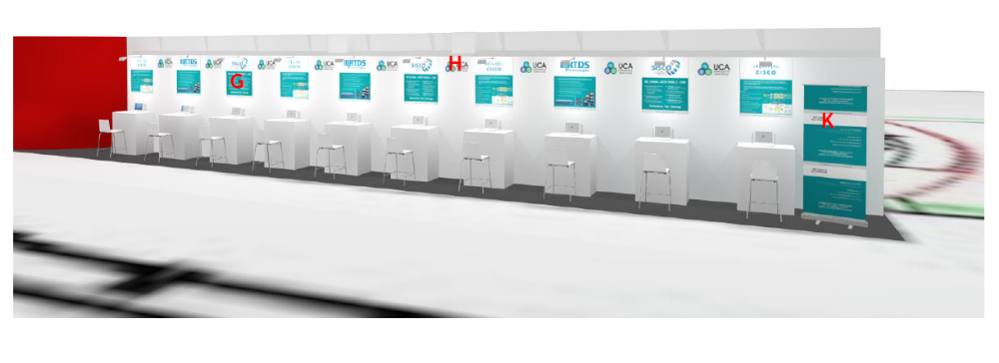
Desk assignment: desk 4 SEL – other desks?
1
2
3
4
5
6
7

Slide 6
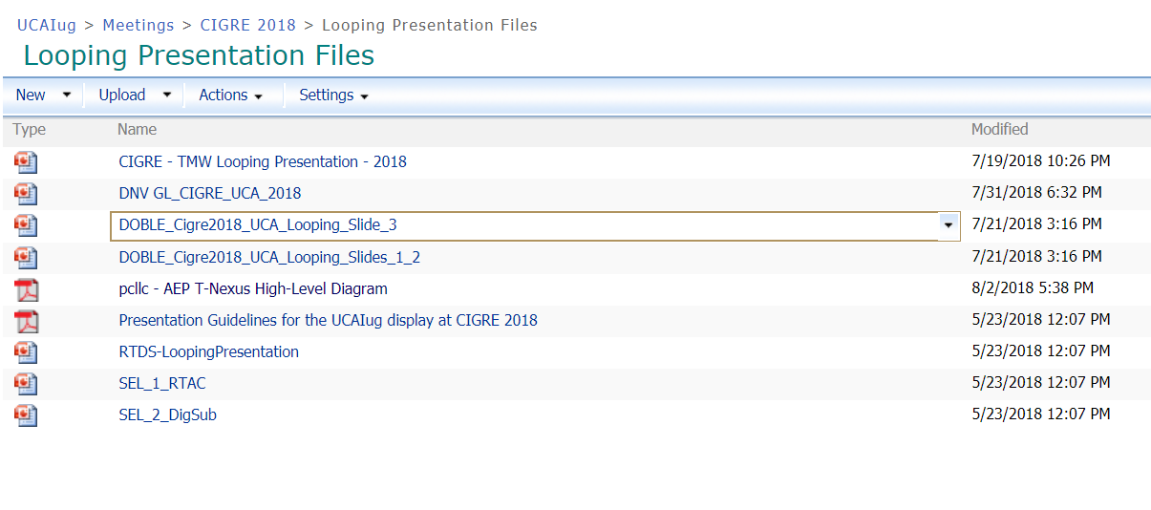
Actionlist
Running presentations-missing: KERI, Opal-RT, SISCO, Schneider, SEL (old files?)

Slide 7
Actionlist
Update Demo Flyer @ printer
Presentation Schedule Poster, approval final schedule
Upload booth presentations to the site (not 1 yet!)
UCAIug Cigre Pressrelease > Press center:
  Pressrelease approved?
Prepare announcement 61850 booth meeting:
  Press center and mailing delegate list

Slide 8
Booth presentations Monday
Time | no | Assigned to
14.10-14.30 | 1 | UCAIug presentation, Margaret
14:30-14:50 | 2 | PCI – ERCOT’s nodal market solution
14:50-15:10 | 3 | SISCO: Data Management Using CIM and IEC 61850
15:10-15:30 | 4 | TMW: Testing HMIs, PLCs, and Protocol Gateways in a Simulated IEC 61850 System
15:30-15:50 | 5 | SISCO: Challenges and Solutions for GOOSE Traffic Monitoring
15:50-16:10 | 6 | RTDS IEC 61850 representation of switchgear, switch controller, and interlocking functions for real-time simulations;
16:10-18.00 |  | UCA 61850 User’s Group Meeting Chair: Bas Mulder

Slide 9
Booth presentations Tuesday
Time | No | Assigned to
12.00-12.30 | 7 | Doble: “Secure and Efficient Testing of IEC 61850-Based Protection and Control Systems” (30 min presentation)
12:20-12:40 | 8 | RTDS: Integrated testing for IEC 61850 compatible IEDs in a simulated smart automation system
12:40-13:00 | 9 | PCI- T-nexus AEP’s Network Model Management Solution
13:00-13:20 | 10 | SEL: 10X: Power System Technology 10 Years Ahead of Industry – International Standards-Based Communications
13:20-13:40 | 11 | TMW: A Better Way To Test: IEC 61850 Testing Features
13:40-14:00 | 12 | SISCO: Challenges and Solutions for GOOSE Traffic Monitoring
14:00-14:20 | 13 | RTDS IEC 61850 representation of switchgear, switch controller, and interlocking functions for real-time simulations;

Slide 10
Booth presentations Wednesday
Time | Slot No | Assigned to
12.00 – 12.20 | 14 | DNV GL IEC 61850 utility profile testing (Bas Mulder)
12:20 – 12:40 | 15 | TMW: Testing HMIs, PLCs, and Protocol Gateways in a Simulated IEC 61850 System
12:40 – 13:00 | 16 | SEL: Wide-Area Synchronized GOOSE Message Analog Data Acquisition Creates Previously Impossible Solutions
13:00 – 13:20 | 17 | SISCO: Applying IEC 61850 to Distributed Energy Resources (DER)
13:20 – 13:40 | 18 | Schneider Electric ‘Process bus in Breaker and a half solutions’ - Tutorial
13:40 – 14:00 | 19 | Schneider Electric ‘IEC 61869 process bus – What are the key differences –
14:00 – 14:20 | 20 | SEL: 10X: Power System Technology 10 Years Ahead of Industry – Cyber Risk and Threat Defenses

Slide 11
Booth presentations Thursday
Time | Slot No | Assigned to
12:00 – 12:20 | 21 | Open
12:20 – 12:50 | 22 | Doble:“Secure and Efficient Testing of IEC 61850-Based Protection and Control Systems”
12:40– 13:00 | 23 | DNV GL PRP/HSR conformance and functional testing on Ethernet switches and IEDs (Bas Mulder)
13:00 – 13:20 | 24 | Schneider Electric Unified IED modeling using IEC 61850 Flexible Product Naming
13:20 – 13:40 | 25 | Schneider Electric ‘IEC 61869 process bus – What are the key differences –
13:40– 14:00 | 26 | SEL: Award-Winning Microgrid Controller Uses GOOSE Messages to Balance Utility Ties and Intermittent Renewables

Slide 12
Any other business
Shipping your collateral: http://www.cigre-exhibition.com/wp-content/uploads/sites/1/Transport-Customs-Handling2.pdf
Booth hand-over: Sun. 26th August, 2pm
Dismantling booth: Fri. 31st August, 4pm

