Slide 1






IEC 61850 Solutions
        Test SCL Files
        Implement IEC 61850
        Translate Protocols
        Test Communications
        Simulate IEDs
        Build IED Templates
        Free Training Videos at TriangleMicroWorks.com
IEC 61850
DNP3
IEC 101
IEC 104
Modbus
OPC
ICCP/TASE.2

Slide 2
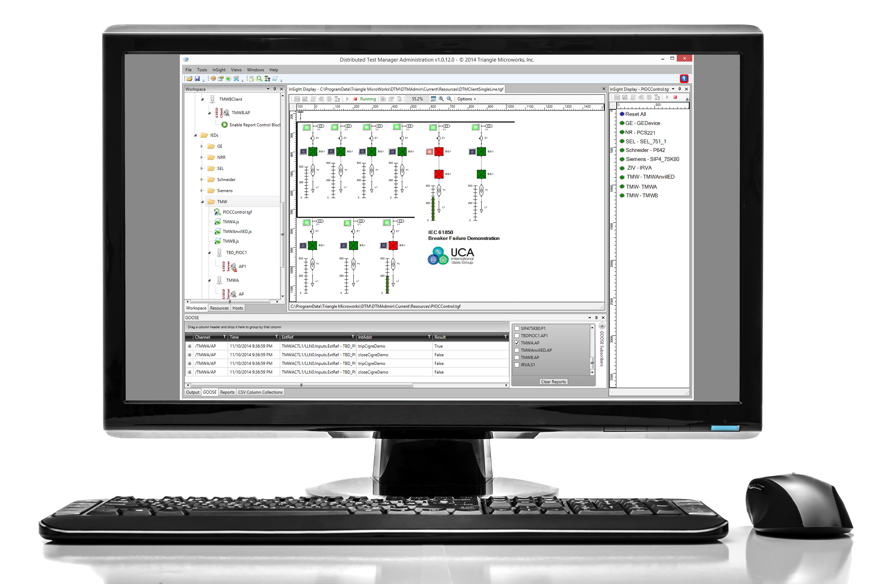
Distributed Test Manager
  System Level Testing
  Verify HMIs, PLCs, RTUs, and Gateways
  Test Devices in a Simulated System
  Automate System Level Tests
IEC 61850
DNP3
IEC 101
IEC 104
Modbus
ICCP
Download a Free Trial
TriangleMicroWorks.com

Slide 3

61850 Test Suite Pro
Test Client
IED Simulator
SCL Tester
GOOSE & SV Sniffer
Data Miner & Visualizer
Make IEC 61850 Testing Easier!
Free Evaluation
TriangleMicroWorks.com

