Slide 1
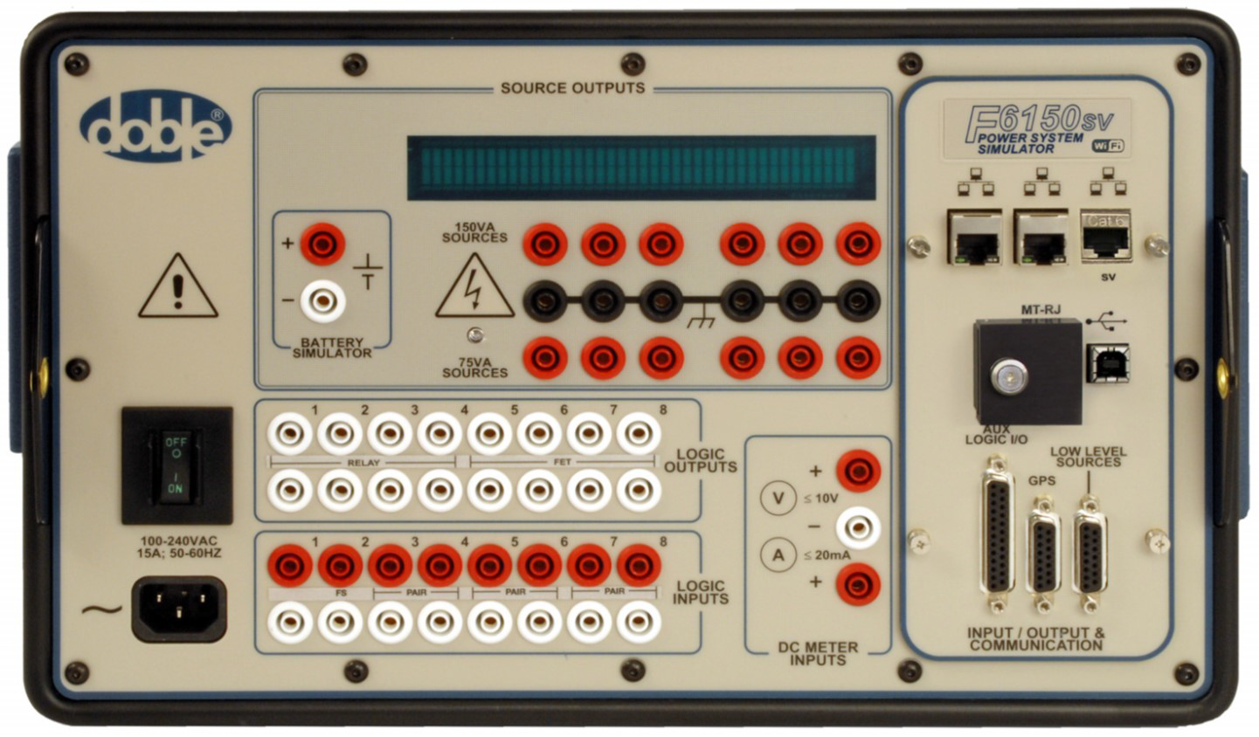
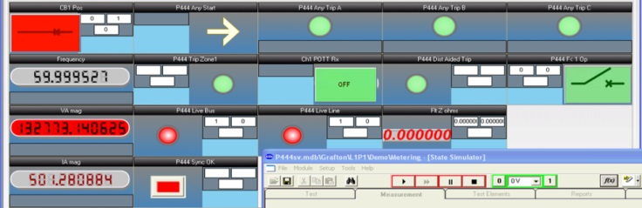
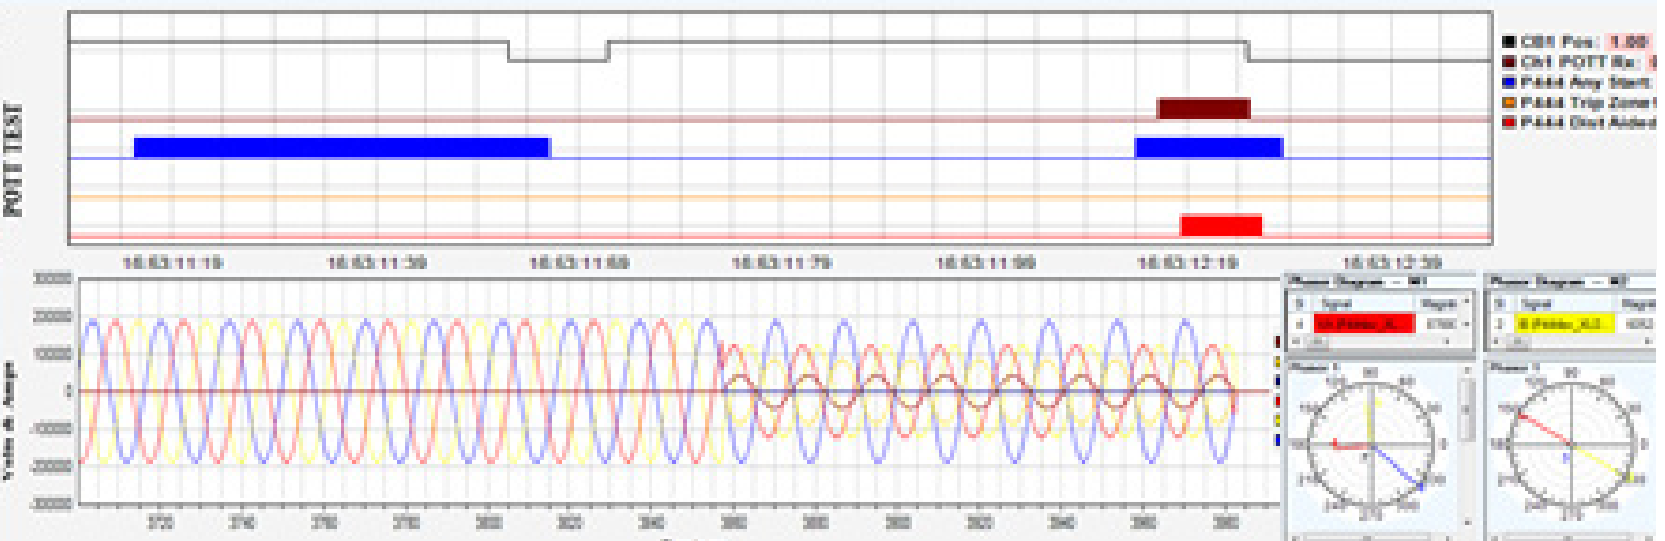
IEC 61850 Testing Solutions
61850TesT software
F6150sv
Test Client and Server
IED GOOSE Simulator
Monitor, Visualize, Record
  Sampled Values
  GOOSE
  Reports
Power System Simulator
GOOSE
Sampled Values
Combine testing with conventional systems

