Slide 1
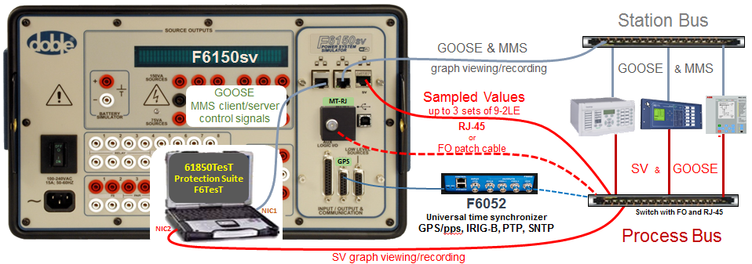
Testing solutions for IEC 61850-based and conventional protection, automation & control systems
6 current sources: 8.75 A, 17.5 A, 35 A, 70 A 3ph or 210 A 1ph
Sampled Values: 3 streams (9-2 LE)
6 voltage sources: 75 V, 150 V, 300 V convertible to currents
up to 3 A, 3ph; or 9 A, 1ph
GOOSE signals: 1024 inputs , 1024 outputs
Conventional logic signals: 8 inputs, 8 outputs
Battery simulator: 300 V

Slide 2
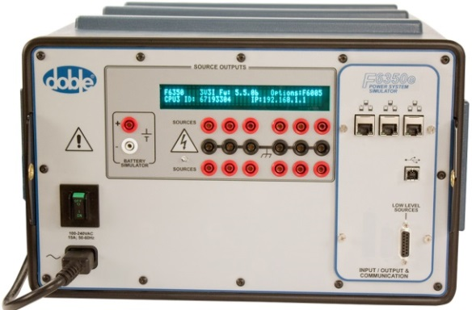
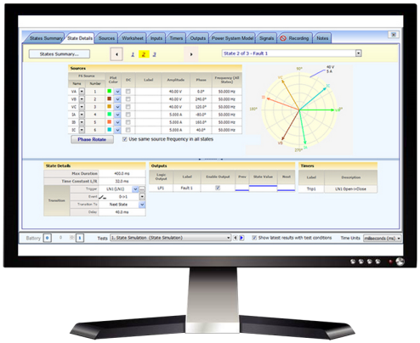
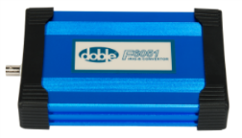
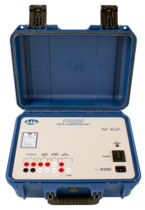

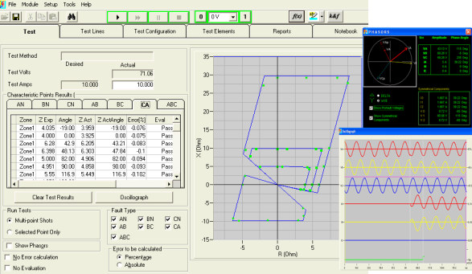
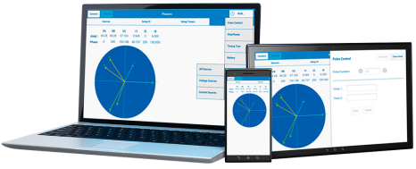
World leader in Power System Protection Testing
Ensure protection system performance through testing, data management and compliance reporting solutions
F6300e & F6350e amplifiers
61850TesT software
Eases IEC 61850 testing
F6051
IRIG-B to GPS converter
High power protection testing
Provides additional current, voltages
Use with Real-time digital simulators for critical protection testing
Protection Suite software
Complete, no-compromise, automated testing for IEDs and protection schemes
F6052 universal time synchronizer
F6080 Field Calibration
F6TesT advanced visual software
Test complex protection functions like differential, impedance, power swing, and more
F6011 Mobile Control Panel

