Slide 1

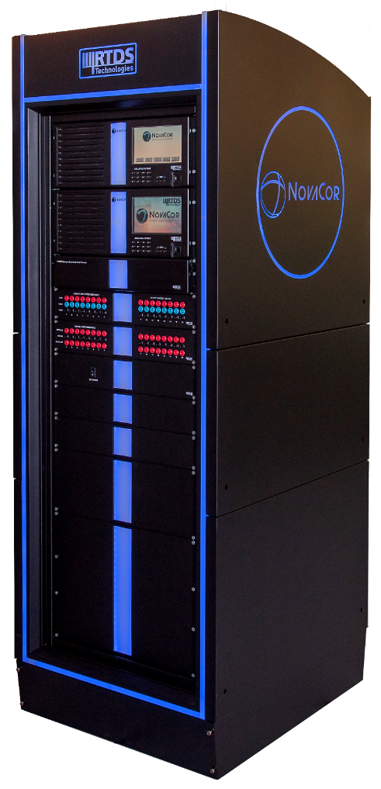
The world’s #1 tool for closed-loop protection system testing
The power industry’s innovators
depend on the RTDS® Simulator.
This powerful tool allows the closed-loop testing of
IEC 61850-compliant protection devices in real time
IEC 61850 MMS Server
IEC 61850 GOOSE messaging
IEC 61850 9-2LE Sampled Values
IEC 61850 XCBR, XSWI, CILO, CSWI, RSYN
IEC 61850 61869 & Chinese National Standard
Stream IEEE C37.118, DNP3, and IEC 61870-5-104 data in real time to test PMU schemes and SCADA systems
Used by manufacturers, utilities, and universities worldwide

Slide 2
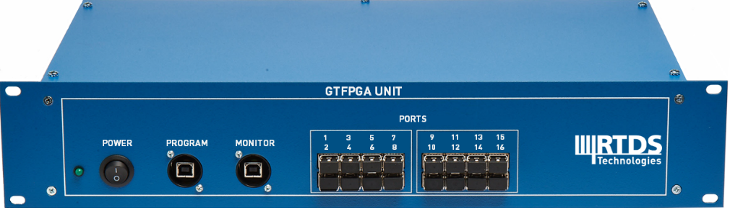
The world’s #1 tool for closed-loop protection system testing
The power industry’s innovators
depend on the RTDS® Simulator.
FPGA-based hardware provides a powerful platform for testing IEC 61850 SV compliant devices in real time
9-2LE mode or 61869-9 mode
Sample rates of 4000, 4800, 5760, and 14400 Hz
New support for HVDC 96 kHz!
Virtually no packet-to-packet jitter
One unit provides 16 SV streams operating autonomously, with 24 channels per stream
Used by manufacturers, utilities, and universities worldwide

