Slide 1
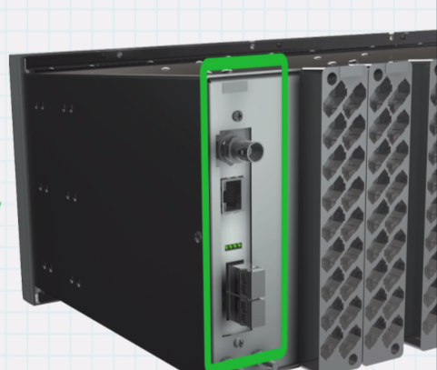


MiCOM P40: Double the Practicality
  Double the Interoperability with IEC61850 Ed1 and Ed 2 by setting
  Double the Operational Security with RBAC (IEC 62351-8)
  Double the Availability with HSR & PRP (IEC 62439), dual IP ports
MiCOM Secured by

Slide 2


