Slide 1
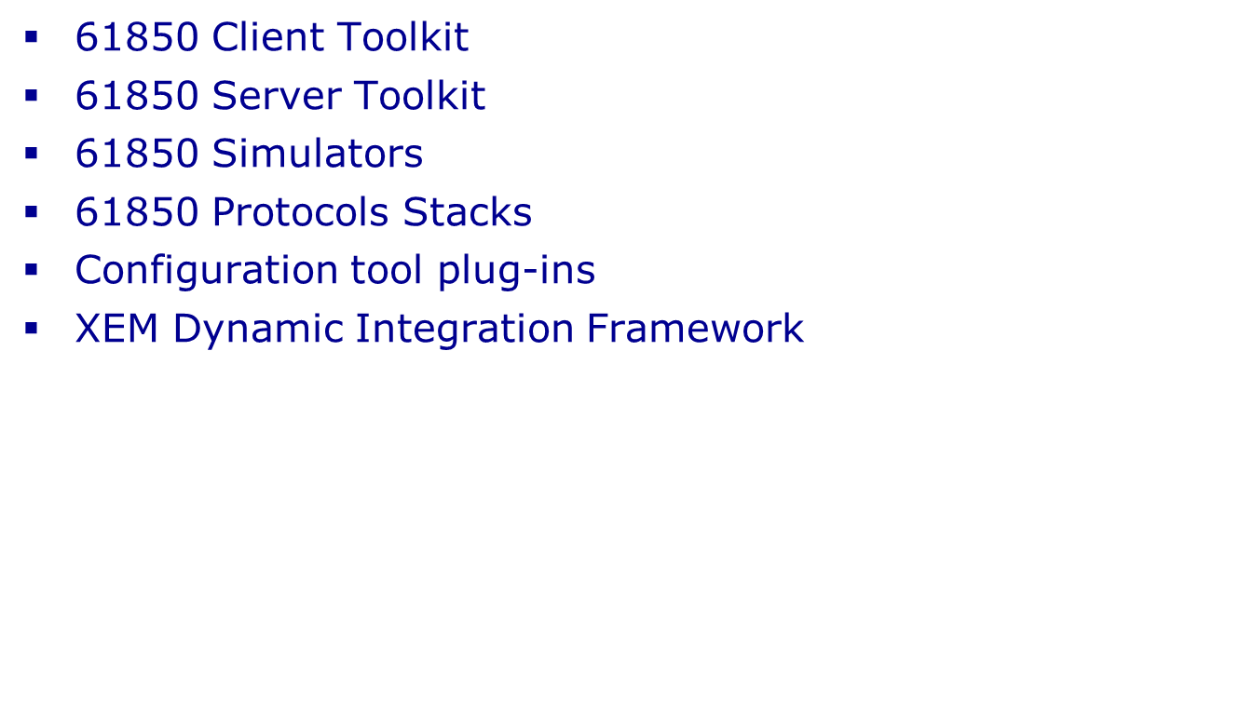
Xelas IEC 61850 overview
Legacy equipment/applications
Browser
Other protocol adapter
Logical script based translator
System process management
Scripting
environment
(Glassfish) J2EE Server
IEC 61850 adapter
IEC 61850/61400
ACSI DATABASE
SCHEMA
JDBC/ ODBC
IEC 61850/61400-25-4
CLIENT
ADAPTER
(or SIMULATOR)
IEC 61850/61400-25-4
SERVER (or SIMULATOR)
Back office
IT
Applications
MMS, GOOSE, SV
Notes:
1
1

Slide 2
Technical Differentiators
Advanced ACSI Management layer
  Automatic updating of SCL, saving development cost and time
  Protocol independent binding, therefore future proof
  All operations supported, easy selection of subsets, allows for easy mapping between devices
Automated validation and regression testing
  Simulators very feature-rich
  Interaction fully scripted (saving manpower)
  Multiple clients and servers, fully distributed environment
  All 61850 standard tests supported
Advanced ICT
  Web GUI and J2EE Webserver
  Client can be RDBM based
  CIM integration
  IEC 62351 security standard support
  Dynamic legacy integration framework

