Slide 1





Enabling Interoperability for the Utility Enterprise
And TESTING

Slide 2







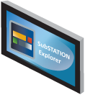









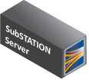























Unified Grid Intelligence
Designed for Multi-Vendor Interoperability
STATION
Intelligence
SYSTEM
Intelligence

Slide 3



61850 Server
SubSTATION HMI
Local Automation
IEC 101/104 Gateway
Active Config Monitoring
Direct Interface to Data Historians
Secure Remote IED Access
Password Management
Configuration Management
Auto Event File Retrieval
Multi-Vendor Compatibility
Device Document Library
Secure Remote
Device Management
Solutions for 61850 Stations

